Slide 2


Slide 3
Lessons From Psalm 23
FAITH – “The Lord is my shepherd.”
IS HE YOUR SHEPHERD?
John 10:11 “I am the good shepherd...."
John 10:16 “there will be one flock {and} one shepherd."
Acts 20:28 “overseers, to shepherd the church of God which He purchased with His own blood."

Slide 4
Lessons From Psalm 23
FAITH – “The Lord is my shepherd.”
IS HE YOUR SHEPHERD?
John 10:27 “My sheep hear My voice, and I know them, and they follow Me.”
Romans 10:17 “"So then faith {comes} by hearing, and hearing by the word of God."
John 10:5 “ they do not know the voice of strangers."

Slide 5
Lessons From Psalm 23
ASSURANCE – “I shall not want”
1 Samuel 17:32-37 “ He will deliver me from the hand of this Philistine."
Psalm 37:23-25 “I have been young, and {now} am old; Yet I have not seen the righteous forsaken, Nor his descendants begging bread."

Slide 6
Lessons From Psalm 23
ASSURANCE – “I shall not want”
Matthew 7:7,8 “everyone who asks receives”
Hebrews 13:5,6 "I will never leave you nor forsake you."
2 Corinthians 9:6-11 “an abundance for every good work.”
Ephesians 1:3 “every spiritual blessing”

Slide 7
Lessons From Psalm 23
“The Lord is my shepherd” FAITH
“I shall not want” ASSURANCE
Hebrews 11:1 {ASV} “assurance of {things} hoped for, a conviction of things not seen.“
Hebrews 10:22 “ a true heart in full assurance of faith”

Slide 8
Lessons From Psalm 23
ASSURANCE – “I shall not want”
Matthew 7:7,8 “everyone who asks receives”
Hebrews 13:5,6 "I will never leave you nor forsake you."
2 Corinthians 9:6-11 “an abundance for every good work.”
Ephesians 1:3 “every spiritual blessing”

Slide 9
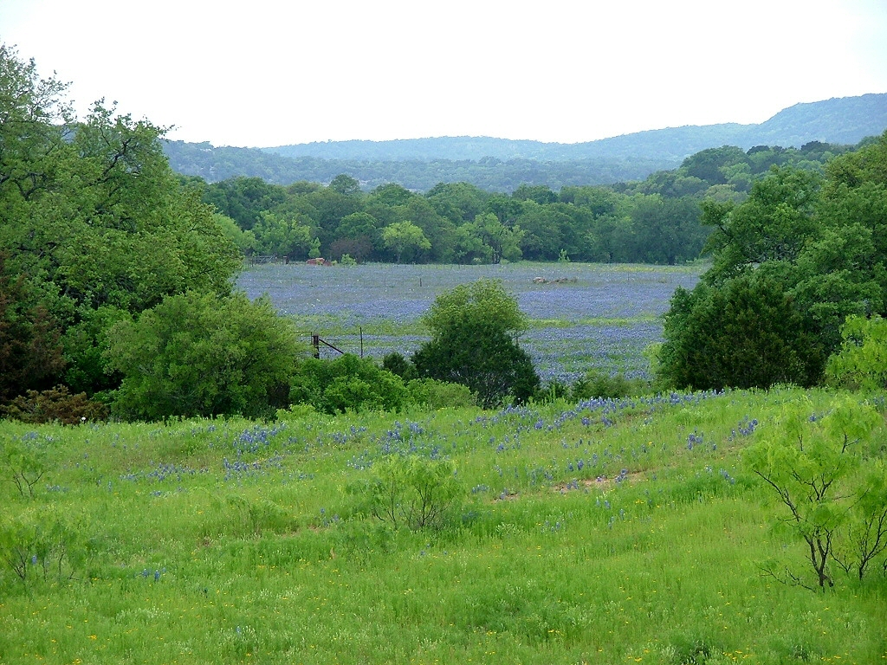
Lessons From Psalm 23
CONTENTMENT – “He makes me to lie down in green pastures”
1 Timothy 6:6-8 “godliness with contentment is great gain."
Luke 12:13-15 "Take heed and beware of covetousness”
Philippians 4:11-13 “I have learned in whatever state I am, to be content”

Slide 10
Lessons From Psalm 23
“He Leads Me Beside The Still Waters” PEACE
Mark 4:36-41 "Peace, be still!"
Isaiah 9:6 “called Wonderful, Counselor, Mighty God, Everlasting Father, Prince of Peace."
Philippians 4:7 “"and the peace of God, which surpasses all understanding, will guard your hearts and minds through Christ Jesus.“
Matthew 5:9 “"Blessed {are} the peacemakers”
Romans 14:19 “pursue the things {which make} for peace”

Slide 11
Lessons From Psalm 23
“He Leads Me Beside The Still Waters” PEACE
1 Peter 3:10-12 “let him seek peace and pursue it.”
Romans 12:18 "If it is possible, as much as depends on you, live peaceably with all men."
Ephesians 4:3 "endeavoring to keep the unity of the Spirit in the bond of peace."
Ephesians 6:10,11 “stand against the wiles of the devil."
1 Timothy 6:12 "Fight the good fight of faith”
2 Corinthians 10:3-6; Jude 3; James 3:17; Matthew 10:34

Slide 12
Lessons From Psalm 23
“He Leads Me Beside The Still Waters” PEACE
James 2:26 “as the body without the spirit is dead,”
Job 14:14 "If a man dies, shall he live again?"
David not afraid to walk “through the valley of the shadow of death.” Why he ate instead of fasting when his son died.
2 Samuel 12:22,23 “I shall go to him, but he shall not return to me."
Psalm 16:10 "For You will not leave my soul in Sheol”
Acts 2:31 “foreseeing this, spoke concerning the resurrection of the Christ”
John 11:25 "I am the resurrection and the life”
John 5:28,29 “all …in the graves will hear His voice and come forth”

Slide 13
Lessons From Psalm 23
“He leads me in the paths of righteousness for His name’s sake” LEADERSHIP
The LORD was leading – DAVID was following
Jeremiah 10:23 “not in man who walks to direct his own steps."
Romans 1:16,17 “it is the power of God to salvation for everyone who believes”
Philippians 3:15,16 “let us walk by the same rule, let us be of the same mind."
Hebrews 12:1,2 “let us run with endurance the race that is set before us, (2) looking unto Jesus, the author and finisher of {our} faith”

Slide 14
Lessons From Psalm 23
“He leads me in the paths of righteousness for His name’s sake” LEADERSHIP
Luke 9:23 “let him deny himself, and take up his cross daily, and follow Me."
Matthew 15:14 “ blind leads the blind, both will fall into a ditch."
John 10:1-4 “ the sheep follow him, for they know his voice."
John 10:11-14 “I know My {sheep}, and am known by My own."
John 6:66-68 “You have the words of eternal life."
Hebrews 2:14,15 “He Himself likewise shared in the same, that through death He might destroy him who had the power of death, that is, the devil”

Slide 15
Lessons From Psalm 23
“He leads me in the paths of righteousness for His name’s sake” LEADERSHIP
Acts 2:24 “whom God raised up, having loosed the pains of death, because it was not possible that He should be held by it."
Romans 10:4 “For Christ {is} the end of the law for righteousness to everyone who believes."
Philippians 3:8,9 “which {is} through faith in Christ, the righteousness which is from God by faith;"
John 16:13-15 “when He, the Spirit of truth, has come, He will guide you into all truth”

Slide 16
Lessons From Psalm 23
“He leads me in the paths of righteousness for His name’s sake” LEADERSHIP
Romans 8:14 “ as many as are led by the Spirit of God, these are sons of God."
1 John 2:5,6 “ he abides in Him ought himself also to walk just as He walked."
1 Peter 2:21 “you should follow His steps:"
Luke 2:49 “I must be about My Father's business?"
Matthew 3:15,16 “it is fitting for us to fulfill all righteousness."

Slide 17
Lessons From Psalm 23
“He leads me in the paths of righteousness for His name’s sake” LEADERSHIP
Hebrews 4:15 “was in all {points} tempted as {we are, yet} without sin."
Matthew 4:23 “preaching the gospel of the kingdom”
Acts 10:38 "how God anointed Jesus of Nazareth with the Holy Spirit and with power”
1 Peter 2:23,24 “He suffered, He did not threaten, but committed {Himself} to Him who judges righteously”

Slide 18
Lessons From Psalm 23
“He leads me in the paths of righteousness for His name’s sake” LEADERSHIP
Revelation 2:10 “ Be faithful until death, and I will give you the crown of life."
Matthew 11:28 "Come to Me, all {you} who labor and are heavy laden, and I will give you rest."
Hebrews 5:8,9 "though He was a Son, {yet} He learned obedience by the things which He suffered. (9) And having been perfected, He became the author of eternal salvation to all who obey Him,"

Slide 19
We Will Continue and Conclude our study next Sunday at 2:00 PM

