Slide 1

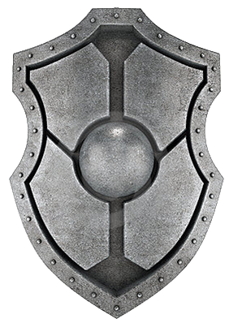
Facing The Future With
FAITH
Teach The Children

Slide 2
Teach Them About God
His Justice & Judgment
  He Knows All
  All Will Be Revealed in Judgment
JOB 34:21, 22; PSA. 139:11, 12; HEB. 4:13
  He Is A Just Judge
1ST COR. 4:5; ECCL. 12:14
His Power
PSA. 7:11; ACTS 10:34
  Created With Just A Word
  None Can Stand Against Him
PSA. 115:5-7; HEB. 11:3; ISA. 40:26
  None Like Him
2ND KGS. 18:33-35; 19:35; JOB 9:12; 12:14
PSA. 89:6-8; 86:8

Slide 3
Teach Them About God
His Mercy
  Not Punishing As We Deserve
  Far Above Our Understanding
PSALM 103:10-18
  What Saved Us
ISAIAH 55:6-9
His Love
TITUS 3:5
  God IS Love
  Sent His Son
1ST JOHN 4:8
  Enables Us To Be His Children
JOHN 3:16; ROMANS 5:8
ROM. 5:10; 1ST JOHN 3:1

Slide 4
Teach Them About God’s Word
It Is For Our Good
  God’s Requirement
DEUTERONOMY 6:24
  Spiritual Life To Us
DEUT. 10:12, 13; JOHN 6:68
JOHN 6:63; ROM. 1:16
Not Too Difficult to Understand
  Some Things Are Hard
  Nothing Is Impossible, Though
2ND PETER 3:16
1ST TIM. 2:3, 4; EPH. 5:17

Slide 5
Teach Them About God’s Word
Not Too Burdensome
  Paul Kept the Faith
1ST JOHN 5:3
  Only If We Don’t WANT To Obey
2ND TIMOTHY 4:7
MATTHEW 19:16-22
Our Judge
  Obedience: Reward
  Disobedience: Punishment
PSA. 19:11; 1ST JOHN 2:25; 2ND TIM. 4:7, 8
2ND THESSALONIANS 1:8

Slide 6
Teach Them To Love
To Love God
  In Worship
  With Our All
JOHN 4:23, 24
  For What He Has Done
MATT. 22:37; ROM. 12:1
To Love God’s Word
1ST JOHN 4:19
  Our Focus
  Precious to Us
PSALM 119:97
  Hidden in the Heart
PSALM 19:10; 119:127
PSALM 119:11

