Slide 2
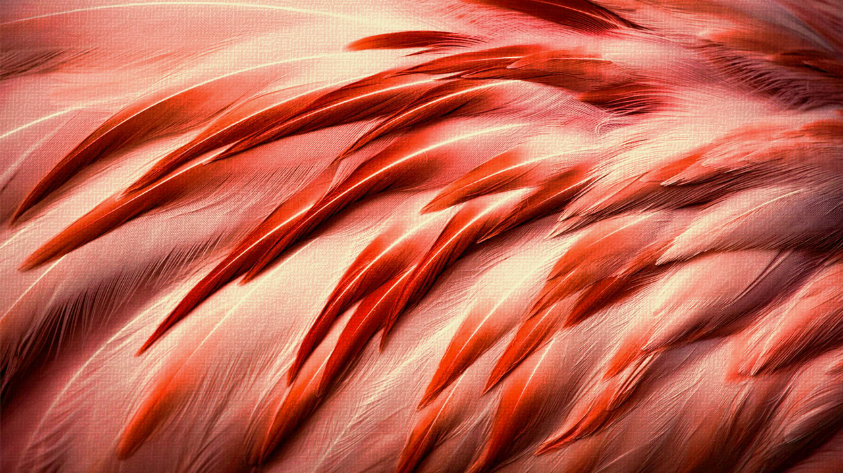
Perfect perfection
From 11 Greek Words

Slide 3
τελειω πληρω
Two Most Common Words

Slide 4
Perfect
Teleioo τελειω “accomplished, complete," Matthew 5:48; Romans 10:2; 1 John 4:17; Hebrews 5:13
Pleroo πληρω “full,” “perfect” in Revelation 3:2; “complete” in Colossians 3:10; “full” in 1 John 1:4
perfection
Teleiosis τελεωσις “thorough equipment,” thus perfection
Katartisis κατρτισις refers to being “thoroughly adjusted,” as in “mending nets” Mark 1:9; “perfectly joined together” 1 Corinthians 1:10; “restore” Galatians 6:1

Slide 5
Absolute Perfection in god alone
Job 37:16 “Him who is perfect in knowledge.”
God is omniscient [Having total knowledge; knowing everything.]
RELATIVELY IT IS SAID OF MEN-
Job 1:8 “blameless and upright man”
Psalm 37:37 “Mark the blameless man”
PERFECTION OF GOD-
Matthew 5:48; Romans 12:2; 2 Samuel 22:31

Slide 6
Perfection of christ
Hebrews 2:10 “perfect through sufferings”
Jesus COMPLETED the TASK of becoming the author of our salvation when He suffered and died for US!
Hebrews 12:2 “Jesus, the author and finisher of our faith”
PERFECT SACRIFICE-
Hebrews 10:11-14 “by one offering He has perfected forever those who are being sanctified.”
Psalm 37:37 “Mark the blameless man”
Hebrews 7:28 “the Son who has been perfected forever.”

Slide 7
Perfect conscience
Hebrews 9:2-14 “with His own blood He entered the Most Holy Place once for all” “how much more shall the blood of Christ, who through the eternal Spirit offered Himself without spot to God, purge your conscience from dead works to serve the living God?”
1 John 1:9 “If we confess our sins, He is faithful and just to forgive us our sins and to cleanse us from all unrighteousness.”
Hebrews 12:2 “Jesus, the author and finisher of our faith”

Slide 8
Perfection in practice
Matthew 5:48 “you shall be perfect, just as your Father in heaven is perfect.”
Matthew 5:43-48 - Context
Romans 12:2 “do not be conformed to this world”
2 Corinthians 13:11 “Become complete.”
Perfection in GROWTH-
Hebrews 5:14 “full age” comes from Teleioo
Philippians 3:8-15 “mature” – “perfect”
1 John 1:8 “sinlessness” not taught in Scriptures

Slide 9
We strive to overcome SIN
The Power of Jesus Christ gives us Forgiveness that Keeps the Devil on the run!

