Slide 2
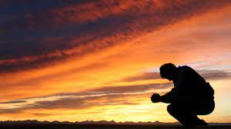
The Beatitudes
Matthew 5:1-12
“Poor In Spirit”
Matthew 5:1-3

Slide 3
The Beatitudes
PURPOSE OF THESE TEACHINGS
Turn upside down the political and social world of Roman Empire and Jewish religious elite of Judea and Jerusalem
Some brethren feel they are unreachable and unattainable virtues.
These are a statements by Jesus of principles that will make up the New Covenant or New Kingdom that was coming
Principles unlike any they have ever heard before – no man has ever delivered such to them
Matthew 7:29 “teaching them as one having authority, and not as their scribes.”

Slide 4

BEATITUDES
“Complete or perfect bliss or blessedness”
Matthew 5:3 NKJV 3 "Blessed are the poor in spirit, For theirs is the kingdom of heaven.
BLESSED
“to pronounce happy or blessed”
“a state or mind, not a moment of fun or pleasure”
Applied to those who are members of His coming kingdom

Slide 5
BEATITUDES
POOR
Poverty, being poor, applies to those whose pockets are empty
Humbled or made low by mere fact he is without power to purchase and do what money can do
Being “poor” in our text refers to what a man “IS” and not upon what he “HAS” in his pockets

Slide 6
BEATITUDES
POOR IN SPIRIT
“Without spiritual strength and independence – lacks power to elevate himself”
“as a poor man is destitute of money, he is destitute of the proud, haughty, arrogant spirit”
The poor in spirit is like the man with the empty purse
Depends on God’s mercy, God’s ability rather than own

Slide 7
BEATITUDES
POOR IN SPIRIT
Sees himself as he really is: LOST, UNDONE, DEPENDENT, DESTITUTE of any saving power
On his knees before God’s throne of power with nothing in his hands to offer but plead for God’s help
Romans 7:24 NKJV 24 O wretched man that I am! Who will deliver me from this body of death?”

Slide 8
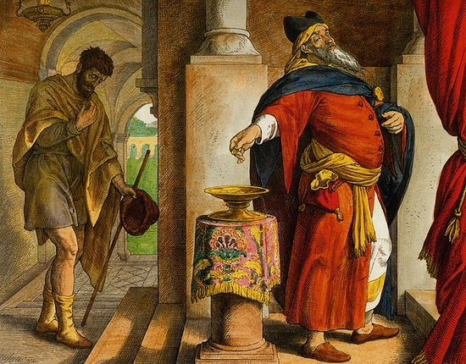
LUKE 18:10-13
"Two men went up to the temple to pray, one a Pharisee and the other a tax collector.”
"And the tax collector, standing afar off, would not so much as raise his eyes to heaven, but beat his breast, saying, 'God, be merciful to me a sinner!’”
WE NEED GOD
WE ARE EMPTY HANDED
POOR AND HELPLESS!

Slide 9
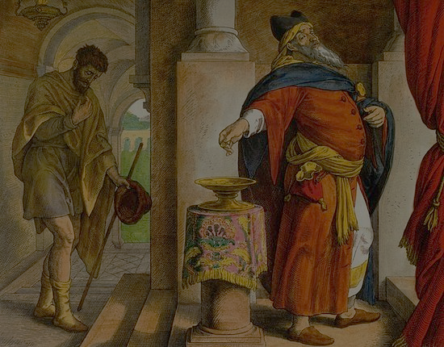
LUKE 18:10-13
"Two men went up to the temple to pray, one a Pharisee and the other a tax collector.”
"And the tax collector, standing afar off, would not so much as raise his eyes to heaven, but beat his breast, saying, 'God, be merciful to me a sinner!’”
The Poor In Spirit Seek God On His Terms Alone!
WE NEED GOD
WE ARE EMPTY HANDED
POOR AND HELPLESS!

Slide 10
“THEIR’S IS THE KINGDOM OF HEAVEN”
Only those with hearts/character emptied of all pride and self worth will find the kingdom
One must become as a “little child” to enter- Luke 18:17
Only when one is lowly of mind, humble and submissive can they find the happiness of the kingdom
Submission, reverence & poverty of spirit overcomes:
Baptism – Acts 2:38; 1 Peter 3:21
Obedience – Hebrews 5:8,9
Continued trust keeping daily commands- 1 John 2:3,4
Having poor spirit keeps one in kingdom – 1 John 5:13

Slide 11
WHAT GIVES US THE MOST TROUBLE?
“SELF” and “PRIDE”
Attitudes opposed to the “poor in spirit” cause us to say such things as:
“I won’t serve”
“I can’t serve”
“I don’t like that”
The “poor in spirit” realize dependency on God and are willing to listen to God always, and serve Him without any pause.

