Slide 2
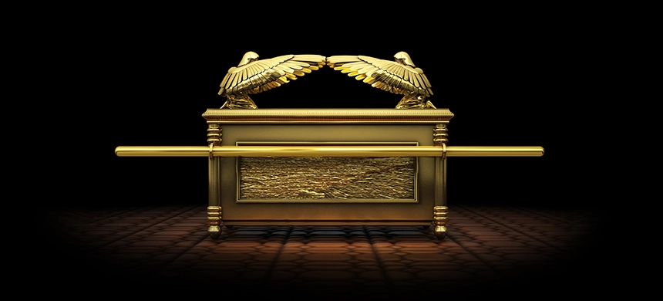
WHY NOT? Leviticus 16:2

Slide 3
God appears in a cloud over the mercy seat
“atonement cover” or “atonement lid”
“the place of atonement”
Psalm 99:1 “dwells between the cherubim”
The Holiness of God is extremely important – Leviticus 16:3 “Aaron shall come into the Holy Place; with the blood of a young bull as a sin offering, and of a ram as a burnt offering.”

Slide 4
Preparation to enter the most holy place
Leviticus 16:3-5
Brought bull for sin offering, and ram for burnt offering….
Clothed ONLY in LINENS!
The Priest would be clothed like a SERVANT!
Two male goats were needed for the sin offering and a ram for the burnt offering on behalf of the people.
God required complete purity before coming into His presence

Slide 5
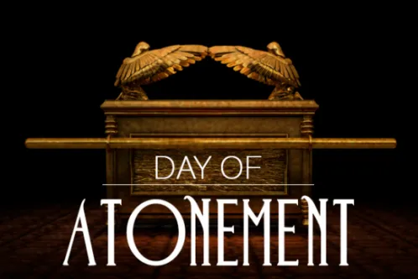
Leviticus 16:6-28

Slide 6
Description of atonement
Leviticus 16:6-10 – describes basic picture of what is happening on the Day of Atonement
Leviticus 16:11-18 – more details and instructions
Bull offered on behalf of the High Priest/his household
Two other goats and a ram offered for the people
Leviticus 16:8 – Aaron to cast lots over two goats
One as an offering and the other as עֲזָאזֵל ‘ a ̆zâ’zêl better known as “scapegoat” – “the goat that departs”

Slide 7
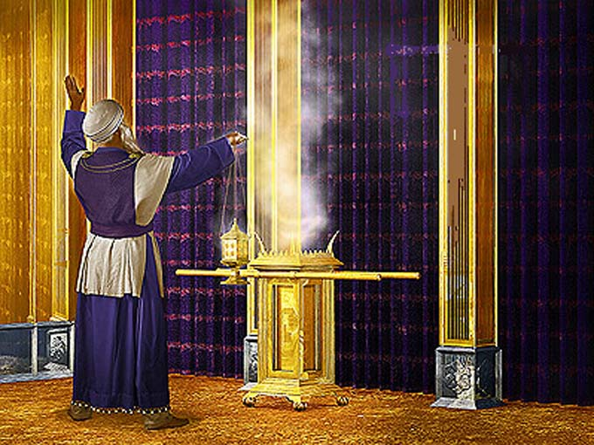
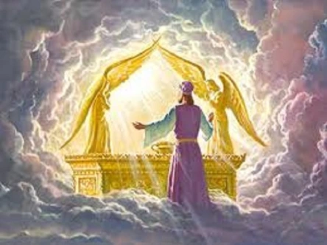
The procedure
Tenth day of the seventh month – activity came to a standstill in Israel
Sprinkle blood of bull in front of the Ark
Blood of sin offering sprinkled over atonement lid and in front of the Ark

Slide 8
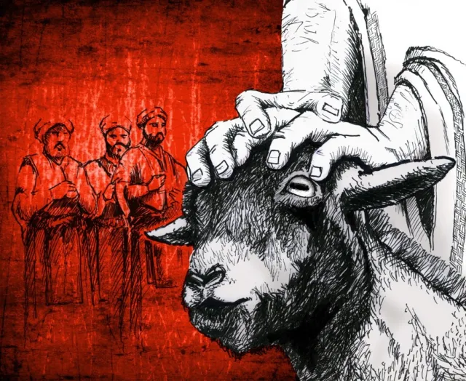
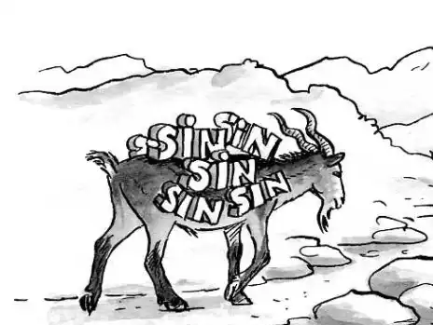
The procedure
High Priest laid hands on head of live goat and confessed sins of the people
The goat was sent away into the wilderness, carrying the sins of the people

Slide 9
Two amazing things about atonement
The Need For Humility – Leviticus 16:29,30
People commanded to “humble themselves”
Consider that the atonement has been made for sins
Jesus Is The Sacrifice of Atonement – 1 Corinthians 5:7 “Christ, our Passover, was sacrificed for us.”
Romans 3:22-25 “whom God offered as a place where atonement by the Messiah's blood would occur through faith....” (ISV)
Romans 3:22-25 “Christ Jesus, 25 whom God set forth as a propitiation by His blood, through faith,...” (NKJV)

Slide 10
Two amazing things about atonement
Propitiation- “ἱλαστ ριον hilastērion 2x the cover of the ark of the covenant, the mercy-seat, the place of propitiation, Rom. 3:25"
Once a year, all sins of people were taken care of and they could start fresh
Jesus is the sacrifice of atonement for the world
Hebrews 9:6-10 “into the second part the high priest went alone once a year, not without blood”
The Holy Spirit indicates a lack of access to holy places and that their daily offerings could not prefect the conscience of the worshiper (9:8,9)

Slide 11
Two amazing things about atonement
Hebrews 9:11-14 “Christ, who through the eternal Spirit offered Himself without spot to God, cleanse your conscience from dead works to serve the living God?”
He did not enter the physical tabernacle – He entered the heavenly tabernacle
He did not enter with animal blood – He entered with His own blood
Do you SEE the POWER of what Jesus did?

Slide 12
Two amazing things about atonement
He is the One offered for our sins
His blood was sprinkled on the place of atonement
Thereby, “securing an eternal redemption”
His blood can purify our conscience from dead works – unlike the blood of animals
Hebrews 9:24-28 “Christ was offered once to bear the sins of many”
The Cross was the DAY OF ATONEMENT for ALL TIME – ending the need for sacrifices

Slide 13
The Goat and the new testament
1 Peter 2:24 “Himself bore our sins in His own body”
Isaiah 53:5,6 “the LORD has laid on Him the iniquity of us all.”
John 1:29 “ "Behold! The Lamb of God who takes away the sin of the world!”
Psalm 103:12 “As far as the east is from the west, So far has He removed our transgressions from us.”
We must humble ourselves
God has cleansed us of our sins through the great sacrifice of Jesus

Slide 14
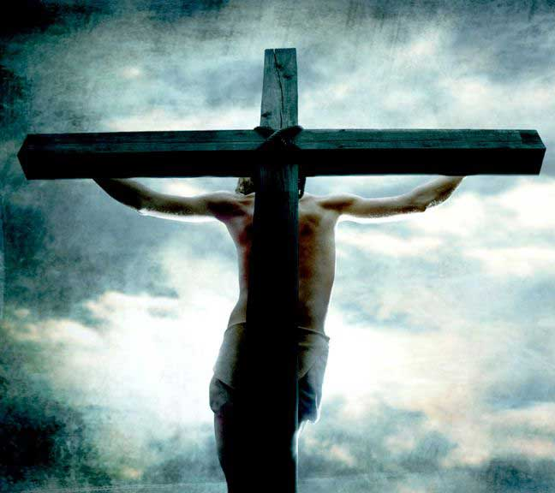
ALL of our sins have been dealt with and removed at the Cross
Praise GOD who loved us and made atonement for us by offering His Son as the sacrifice of atonement for us

