Slide 2


Slide 3
Full Preterism
Latin “praeter” – past
“deems all biblical prophecies as past or already fulfilled.”
“the prophecies in the Apocalypse have already been fulfilled. ”

Slide 4
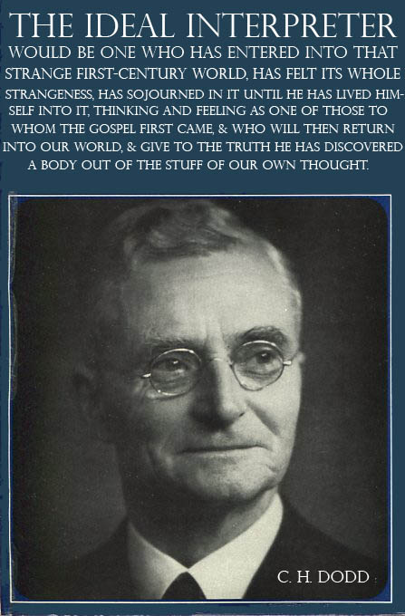
Realized eschatology
C. H. Dodd – cir. 1930
“holds that the eschatological passages in the New Testament do not refer to the future, but instead refer to the ministry of Jesus and his lasting legacy.”

Slide 5
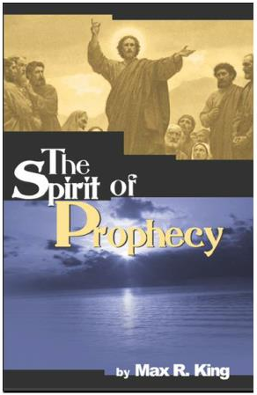
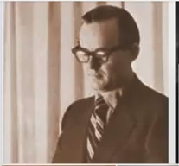
covenant eschatology
Max King – cir. 1980
“contended that biblical eschatology was not related to the end of the space-time universe, but to the transition of the Old Covenant to the New Covenant.”

Slide 6

transmillennialism
Tim King – cir. 2000
“By 1999 we began to look long- term at what it would take to extend Max’s research as a second generation and prepare the church for the postmodern age…. In the summer of 1999 we invented a new word – "Transmillennialism. " As a new term, this could stand beside ‘pre-, ’ ‘a-, ’ and ‘post-’ millennialism, the final forms that had developed in Christian eschatology….”

Slide 7

All happened in a.d. 70
All Bible prophecy was fulfilled completely
The kingdom came with power.
The second coming of Christ occurred.
The Judgment Day took place.
The dead were raised and death was conquered.
The Law of Moses ended.
Satan’s rule ceased.
The world ended.
Heaven and Hell began.

Slide 8
“nothing new under the sun”
Retelling of an Old Error
1883 – Dr. A. Wilford Hall – Universalism Against Itself – ““Universalism teaches that this important event (the coming of Christ) took place at the destruction of Jerusalem, nearly 1800 years ago. This position is taken in order to avoid, if possible the admission of a future general judgment, which every where stands closely connected with the second coming of Christ” (p. 91).

Slide 9
“nothing new under the sun”
C.H. Dodd 1930 “final events were all fulfilled in the personal ministry of Jesus”
“Eschatology” – “the doctrine of the last things.”
“Realized Eschatology” – the doctrine of completed last things

Slide 10
Why some fall for this error
Because some passages describe a “coming” in a local judgment on Jerusalem – Matthew 24:1-34
Some erroneously contend all New Testament references to “coming” of Christ in judgment must allude to the destruction of Jerusalem
Ignores Scriptures portray Jesus as “coming” in number of different senses

Slide 11
Why some fall for this error
Jesus “came” to earth as a human being – Luke 19:10
He “came” when church was established on Pentecost – Matthew 16:28; Mark 9:1
He comes to discipline congregations – Revelation 2:5
He has promised to “come” in a universal judgment – Matthew 25:31,32; John 5:29

Slide 12
Why some fall for this error
James 5:7,8 “for the coming of the Lord is as hand”
2 Thessalonians 2:2 “not to be soon shaken in mind or troubled, either by spirit or by word or by letter, as if from us, as though the day of Christ had come”
The Second Coming is always “at hand” because of its secretive nature- 1 Thessalonians 5:1-3 “day of the Lord so comes as a thief in the night”

Slide 13
Kingdom of god
“did not come until A.D. 70 (Matthew 16:28; Mark 9:1), for this coming kingdom is connected with a “coming” of Christ”
Kingdom of God / The church Matthew 16:18,19; Acts 20:28; Revelation 1:5,6
The church in existence on Pentecost – Acts 2:47

Slide 14
Kingdom of god
Expresses the reign of Christ
Jesus began reigning prior to A.D. 70- Matthew 28:18; Acts 2:29-31; Ephesians 1:19-23
Mark 9:1 Jesus says the Kingdom will come with power
Luke 24:49 – Told apostles to stay in Jerusalem until clothed with power from on high

Slide 15
Kingdom of god
Power promised in Acts 1:4, connected with coming of the Holy Spirit on the Apostles in Acts 1:8
The Holy Spirit did NOT come upon the Apostles in A.D. 70, but on Pentecost- Acts 2:1-4

Slide 16
baptism
John 3:3-5 – one cannot see the kingdom of God unless they are baptized
IF the kingdom of God did not come until A.D. 70, why did Apostles preach and practice baptism long before this?- Acts 2:38; 8:12
Colossians 1:13 “For He delivered us from the domain of darkness, and transferred us to the kingdom of His beloved Son” (Colossians 2:10)

Slide 17
The second coming
Matthew 24 & Second Coming different:
1. 2nd Coming will be sudden, unexpected, as a thief comes in the night – Luke 21:20; 1 Thessalonians 5:1-3
2. Life on earth for Christians followed destruction of Jerusalem (Luke 21:21-24), yet life on earth will not follow for Christians at the 2nd Coming – 1 Thessalonians 4:17,18

Slide 18
The second coming
3. At destruction of Jerusalem coming of Jesus was invisible that only believers would perceive (Matthew 24:33), at 2nd coming He will come as He left, VISIBLE (Acts 1:11).
4. Destruction of Jerusalem was a judgment on a particular city, but the 2nd coming involves all nations – Matthew 25:31,32; Revelation 1:7 “Behold, He cometh with the clouds; and every eye shall see Him, and they that pierced Him, and all the tribes of the earth shall mourn over Him”

Slide 19
The end of the world
King “2 Peter 3 was fulfilled and the destruction of Jerusalem.”
1. Judgment in 3:9,10 paralleled judgment of days of Noah (3:3-7). A universal judgement, not local!
2. King argues “world” is not the material world, but “Jewish world” or passing of Jewish economy. “World” destroyed by flood was the physical planet (3:6) “present heavens and earth” (3:7)

Slide 20
The end of the world
3. V. 10 it is clear that this is the physical creation being destroyed. “Burning” & “destruction” cannot be figurative, because judgment that parallels it was not figurative (3:3-7). Planet itself is DESTROYED!
4. “New heavens and new earth” not life on this planet after destruction of Jerusalem – Christians still persecuted, and this world filled with evil (2 Peter 3:13)

Slide 21
The end of the world
King argues that Matthew 5:18 teaches that the Law of Moses was removed in A.D. 70
The Apostles clearly taught that the Law ended at the cross - (Colossians 2:14-16 “nailed it to this cross”; Ephesians 2:15 “having abolished in His flesh the enmity, that is, the law of commandments”; Hebrews 9:15-17 “where there is a testament, there must also of necessity be the death of the testator.”; 10:9-10 “take away the first…establish second”)

Slide 22
The end of the world
IF the expression “heaven and earth pass away” refers to the destruction of Jerusalem…..
DID Jesus’ words pass away when Jerusalem was destroyed? Matthew 24:35

Slide 23
The resurrection
King argues resurrection in such places as 1 Corinthians 15 is from the grave of Judaism. (The Spirit of Prophecy, King, p.220)
1. Resurrection in 1 Corinthians 15 is a bodily – paralleled to Jesus’ (15:12-18)
2. Resurrection happens when:
  Kingdom delivered up (15:24)
  At the “end” (15:24)
  Jesus STOPS RULING (15:25)
  All God’s enemies defeated (15:25)
  Death completely defeated (15:26,55)

Slide 24
The resurrection
3. Is the resurrection of “bodies” (15:35), composed of “flesh” (15:39)
4. Interpreting this as being resurrection of the church:
  When did the church die?
  The “body” raised in this chapter was planted as a “perishable,” “dishonorable,” “weak” and “natural” body (15:42-44)
  The “body” raised is NOT the same that was sown!
  The church established on the day of Pentecost, was not a perishable, dishonorable, weak, and natural body!

Slide 25
Various problems
Baptism paralleled to the resurrection of Christ (Romans 6:3-5) but seeing resurrection is PAST, does baptism have any validity?
The Lord’s Supper to be observed until He comes (1 Corinthians 11:26), if He has COME, where is authority to partake?
Jesus said in the resurrection they “neither marry, nor are given in marriage” (Luke 20:35) IF it has already happened, then Christians do not have a right to marry!
Jesus said after resurrection “neither can they die anymore” (Luke 20:35)

Slide 26
Hymenaeus & philetus
2 Timothy 2:16-19
“who have strayed concerning the truth, saying that the resurrection is already past; and they overthrow the faith of some”
Full Preterism Still Makes Shipwreck Of The Faith!

