Slide 2
Which State Are You In?
“a mode or condition of being…”

Slide 3
Spiritual State
Unbelieving
Believing
Repenting
Saved

Slide 4


Slide 5
Unbeliever
John 20:30,31 “these are written that you may believe that Jesus is the Christ, the Son of God”
Hebrews 11:6 “without faith {it is} impossible to please {Him} [GOD]”
Romans 10:9,10 “with the heart one believes to righteousness”
Romans 10:17 “faith {comes} by hearing”
Acts 16:27-32 “Sirs, what must I do to be saved?”
A Man in a state of UNBELIEF needing to come into the state of BELIEF!

Slide 6
Believer
Must believe Jesus was conceived by the power of GOD- Matthew 1:18-23
He was with God in Heaven before the world was created- John 8:51-58
He walked on the face of the earth some 2,000 years ago, preaching the good news of salvation through His death!
He died unjustly on a Roman cross, was buried & rose on the third day, victorious over death & the grave!
He NOW reigns over His kingdom from His throne at the right hand of God, in Heaven!
This is what the New Testament was written to CAUSE you to BELIEVE!

Slide 7
Believer
Mark 16:15,16 Mark 16:15-16 NKJV 15 And He said to them, "Go into all the world and preach the gospel to every creature. 16 "He who believes and is baptized will be saved; but he who does not believe will be condemned.”
DO YOU BELIEVE?
Then YOU are in the STATE OF BELIEF!
“What Shall We Do?” – Acts 2:36-38
They already believed, so they were told to REPENT!

Slide 8
Spiritual State
Unbelieving
Believing
Repenting

Slide 9
Penitent
REPENT- “to think differently or afterwards, i.e. reconsider (morally, feel compunction).”
The BELIEVER makes up his mind to TURN FROM SIN and TURN TO GOD is one who has REPENTED
2 Corinthians 7:10 “godly sorrow produces repentance to salvation”
Recognition that one is in the state of UNBELIEF and a desire to CHANGE states into the state of BELIEF, will rapidly bring one to the point of REPENTANCE!
Has your MIND changed in the direction of SERVING GOD through JESUS CHRIST?

Slide 10
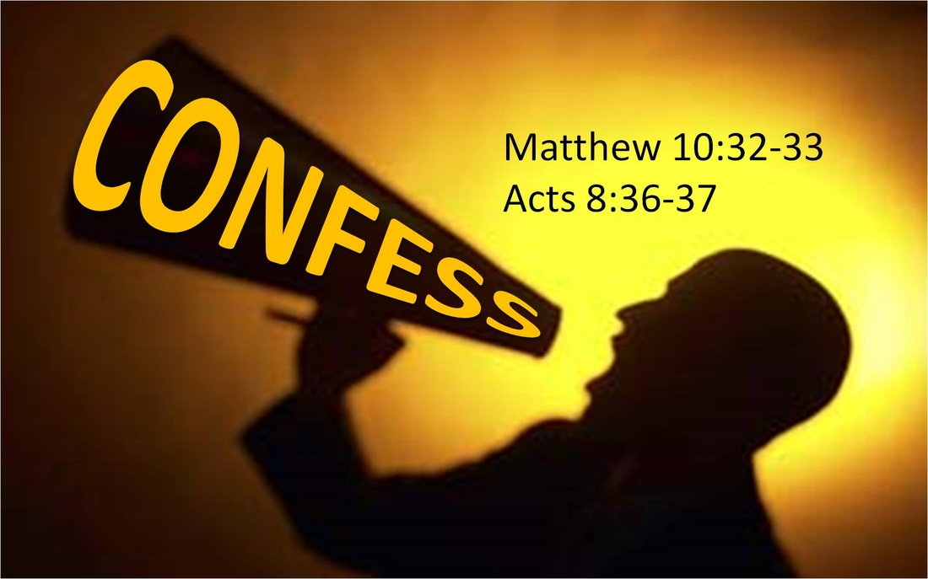

Spiritual State
Unbelieving
Believing
Repenting
Saved

Slide 11
Saved
Acts 16:32-34 “..they spoke the word of the Lord to him and to all who were in his house.” “he took them the same hour of the night and washed {their} stripes. And immediately he and all his family were baptized.” “having believed in God with all his household.”
Acts 22:16 “Arise and be baptized, and wash away your sins, calling on the name of the Lord.”
It is a SHAME for someone to come through the states that lead up to the shores of BAPTISM, and then STOP SHORT of crossing over into the SAVED STATE!

Slide 12
Which State Are You In?
“a mode or condition of being…”

Slide 13
Saved State
Studying – 2 Timothy 2:15; 3:15
Grow- 2 Peter 3:18; 1 Peter 2:1,2; 2 Peter 1:2-4
Assembling Together Regularly – Hebrews 10:25; Acts 20:7
Give as they are prospered- 1 Corinthians 16:2
Abstain from every form of evil- 1 Thessalonians 5:22
Teaching – Matthew 28:19,20
Running the race- Hebrews 12:1,2
Obeying Christ – Hebrews 5:8,9
Always Praying – 1 Thessalonians 5:17
Warning the Lost – 2 Thessalonians 1:6-10
Trying the spirits – 1 John 4:1; Revelation 2:2; Jude 3
Fight the Good Fight – 1 Timothy 6:12

Slide 14
Spiritual State
Overtaken Believer
Repent And Pray
Acts 8:22
Confess Your Faults
James 5:16
Be Restored
Galatians 6:1
2 Peter 2:21

Slide 15
Which State Are You In?
“a mode or condition of being…”

Slide 16
Spiritual State
Believing
Repenting

Slide 17
Spiritual State
Overtaken Believer
Repent And Pray
Acts 8:22
Confess Your Faults
James 5:16
Be Restored
Galatians 6:1
2 Peter 2:21

